Slide 1
European Soccer Data –Goal & draws Analysis Soumya Chatterjee

Slide 2
Dataset(s)
Data Set used for Analysis
Soccer Dataset
What you get:
+25,000 matches
+10,000 players
11 European Countries with their lead championship
Seasons 2008 to 2016
Players and Teams' attributes* sourced from EA Sports' FIFA video game series, including the weekly updates
Team line up with squad formation (X, Y coordinates)
Betting odds from up to 10 providers
Detailed match events (goal types, possession, corner, cross, fouls, cards etc...) for +10,000 matches

Slide 3
Motivation
As a passionate soccer enthusiast and as a data science enthusiast I was keen to understand and visualize the soccer dataset in terms of Goal & draws recorded in the data set. This exploratory analysis will help us answer the following
Top Leagues Where Most number of Goals Scored ( 2008 to 2016)
Top Goal Scoring teams
And an Indication on which League I should avoid as it has most number of matches as draws. ( I as a fan wants to see matches which are heavy on Goals)
Hopefully this analysis will guide the soccer enthusiast to watch the most exciting European league & matches ,and avoid the scoreless matches.
Lets Gets Started !!!!!!!!!!!!!

Slide 4
Research Question(s)
Find the Top 2 European Leagues in terms of number of Goals scored
Goal comparison between Home Goals vs Away Goals, to find in which league most number of Home Goals are scored ?
Goal comparison between How Goals vs Away Goals ,to find in which league most number of away Goals are scored ?
Find the TOP 10 teams by there Home and away goals.
Most Number Matches with 0-0 score lines by league.

Slide 5
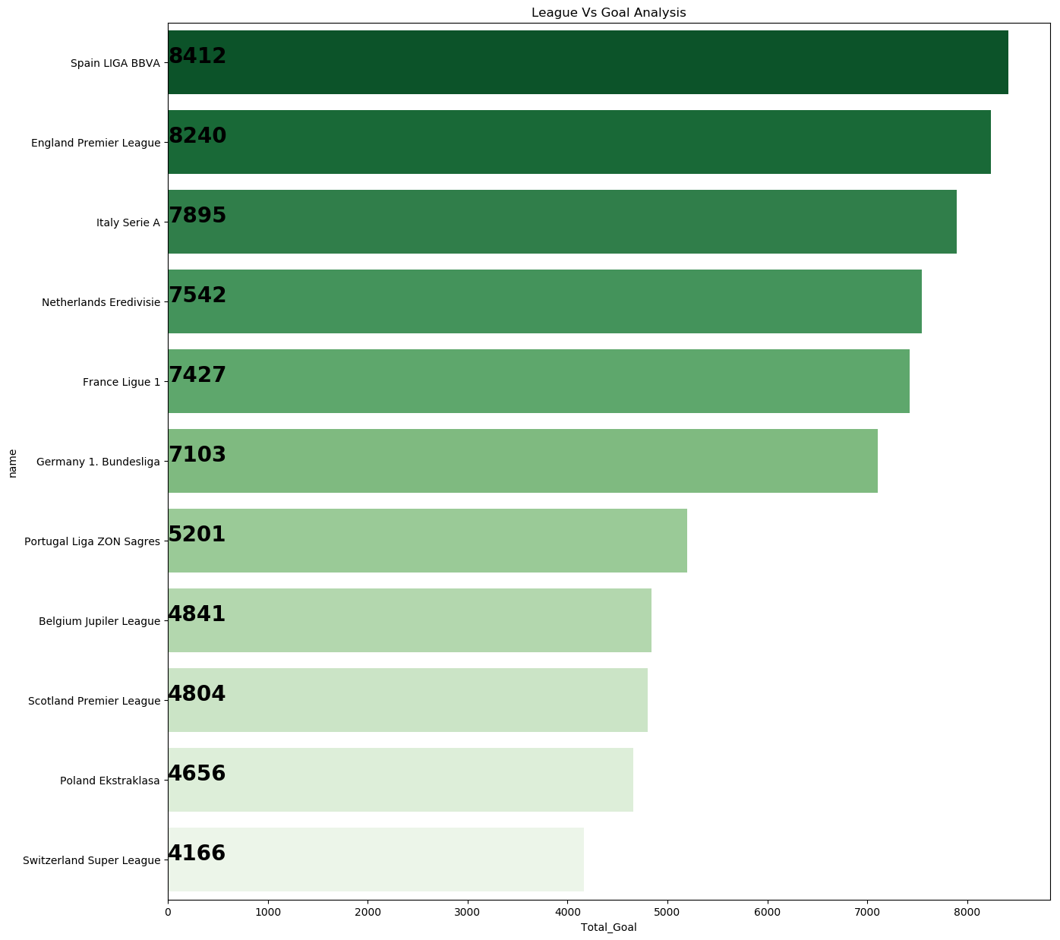
Findings (1)
The Top 2 Teams in the European League are Spanish Liga (8412 goals) and England Premier League (8240 goals)

Slide 6
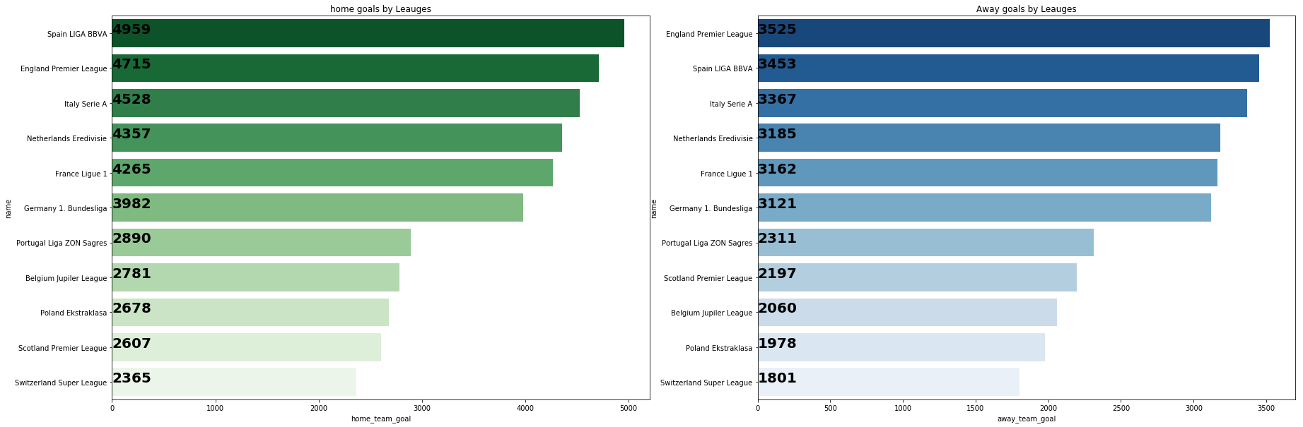
Findings –(2 & 3)
Most Number of Home Goals are scored in Spain LIGA and Most Number of away Goals scored at England Premier League

Slide 7
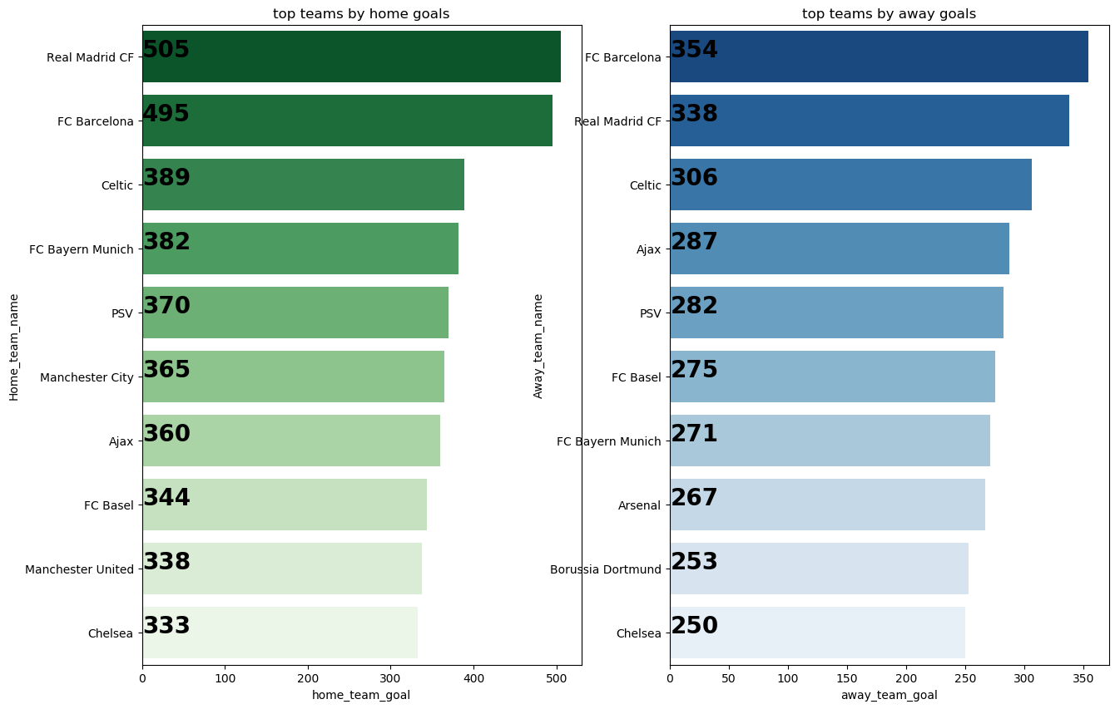
Findings –(4)
TOP 10 teams by there Home and away goals are Shown below – Real Madrid & FC Barcelona are the Most Goal Scoring Teams

Slide 8
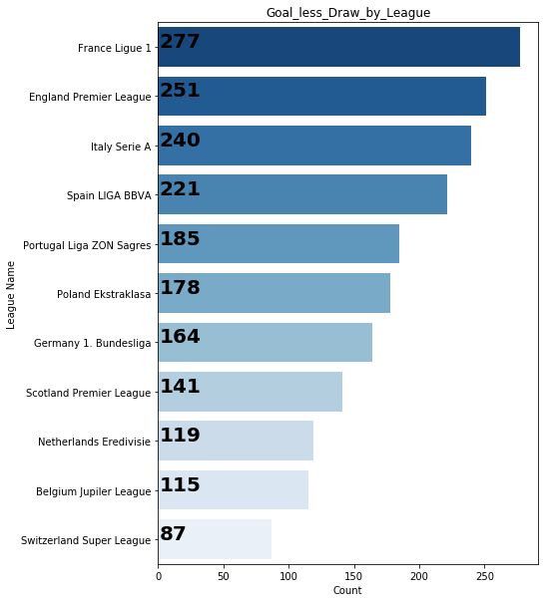
Findings –(5)
Most Number of Scoreless draws were Observed in – France Ligue 1 & Least was observed in Switzerland Super league

Slide 9
Acknowledgement
Didn’t receive any feedback on the work

Slide 10
Reference
Bar plot using seaborn library - https://seaborn.pydata.org/generated/seaborn.barplot.html
Bar plot
https://preinventedwheel.com/easy-matplotlib-bar-chart/

